Slide 1



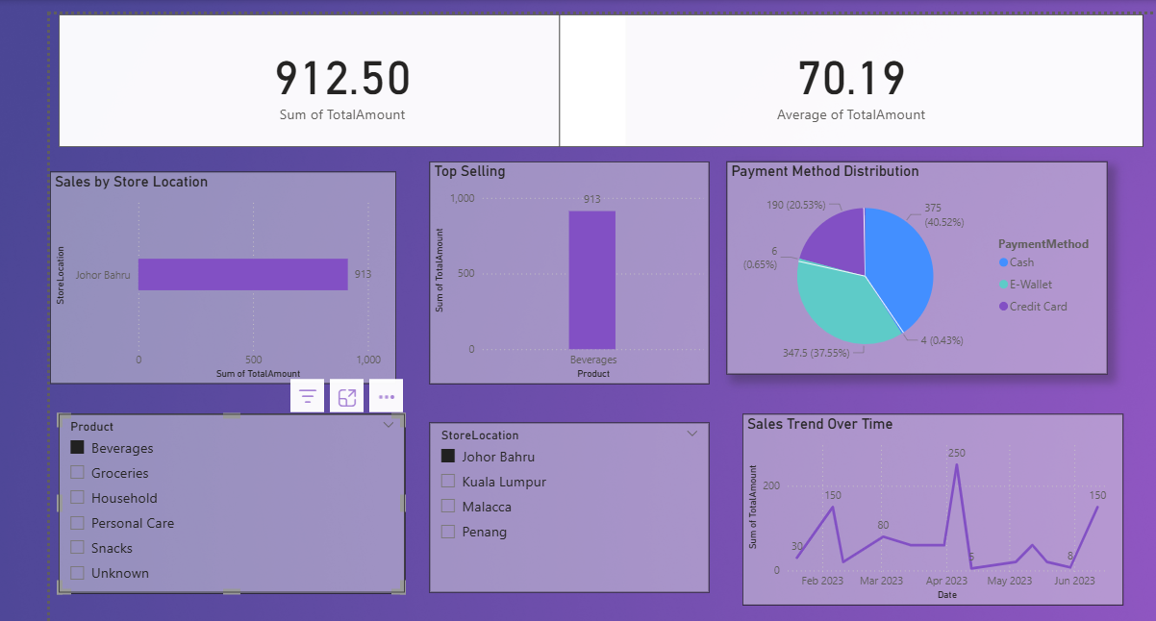

Sales data
Analysis
Start Slide

Slide 2
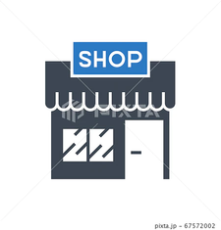
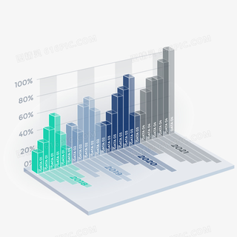
Introduction
01
02
We gathered retail sales transaction data from keggle and analyzed using pandas and some sql. The goal was to understand customer behavior, product performance, store location sales, and payment choices. This report shows current performance and points out areas for future growth.
03

Slide 3
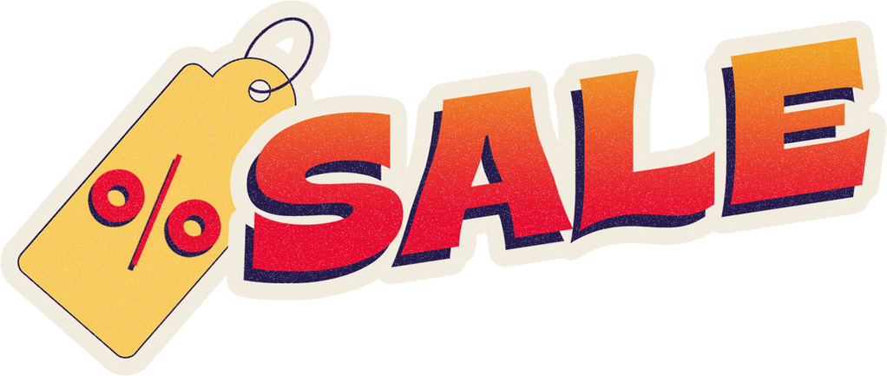
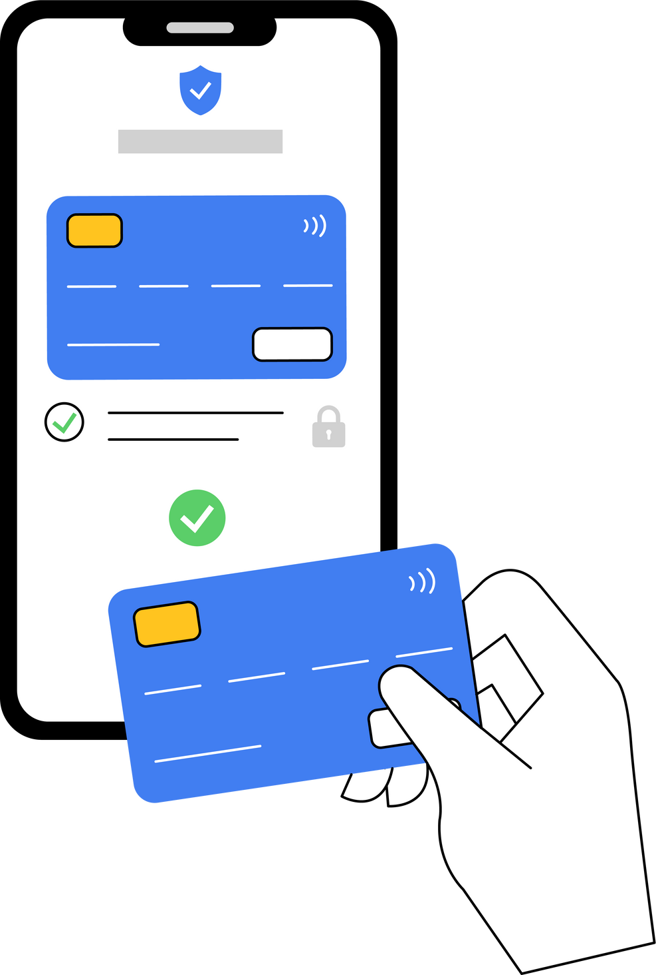
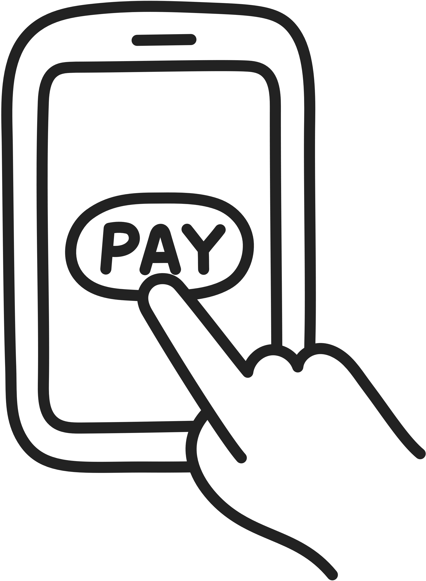

What are the best-selling products?
Problem: Retailer does not know which categories contribute most to sales.
Solution: Analyze sales totals by product to find top contributors.
Action: Focus promotions and inventory on best-performing categories.
WHAT IS THE PREFERRED PAYMENT METHOD?
Problem: Retailer is unsure which payment method customers prefer.
Solution: Compare transactions and revenue across payment types.
Action: Expand popular options (e.g., E-Wallets), create promotions with providers.
WHICH STORE LOCATION PERFORMS BEST?
Problem: Retailer does not know which branch is most profitable.
Solution: Compare revenue and transactions by location.
Action: Increase stock in high-demand stores, investigate weaker branches.

Slide 4
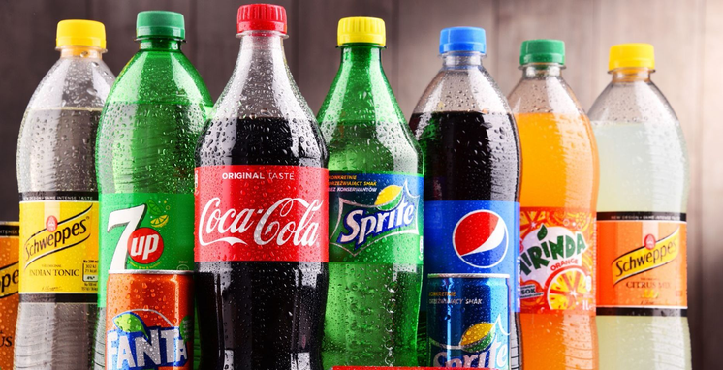

Top-Selling Products
The best-selling products were beverages and personal care, making up over 40% of total sales. Snacks, groceries, and household products also sold well. This shows that customers focus on buying daily-use and convenient items.

Slide 5
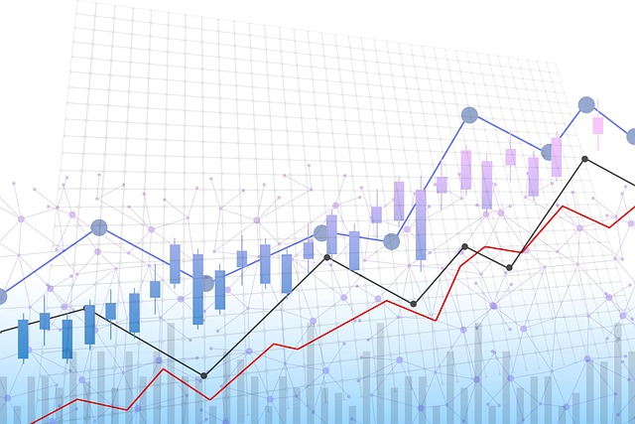
Descriptive Statistics
On average, each customer bought about 3 items per visit. The average price per item was RM 17.42, with prices ranging from RM 2.50 to RM 50.00. The average sale per transaction was RM 52.90, while the highest sale reached RM 250.00. This shows the store focuses on FMCG products, which are bought often in small or medium amounts.

Slide 6
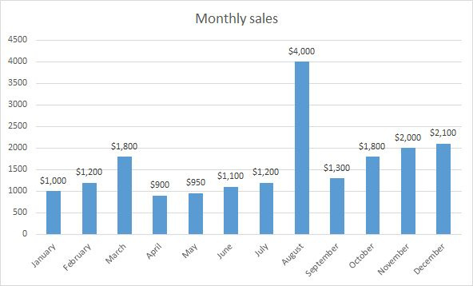
Monthly Sales Trends
01
Sales went up and down during the year, with higher sales during festivals, promotions, and holidays. The biggest sales came during Ramadan, Hari Raya, and year-end shopping. The store should plan promotions during these busy times to increase revenue.
02
03

Slide 7
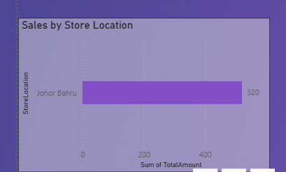
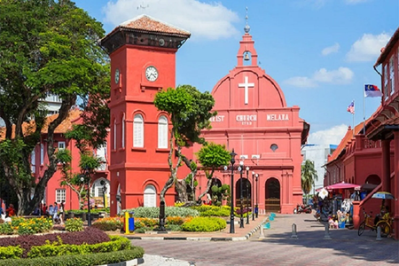
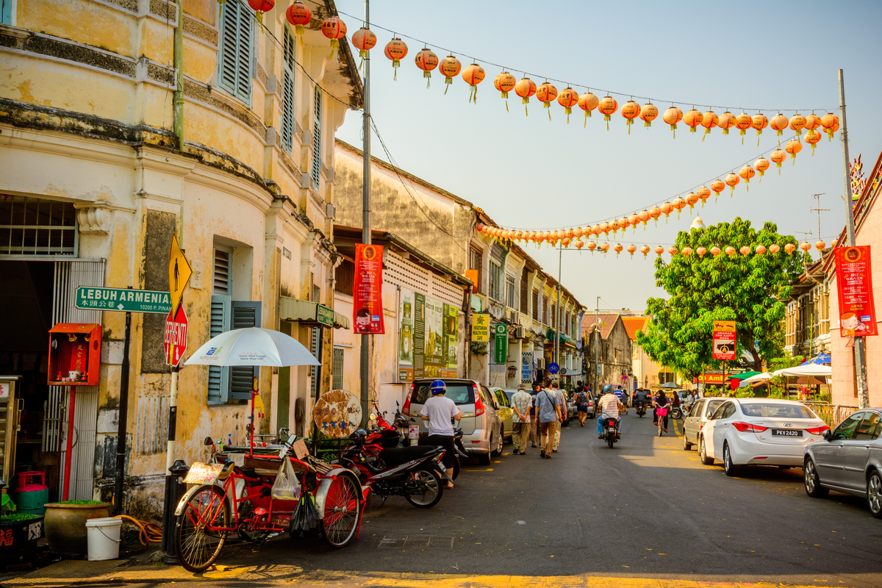
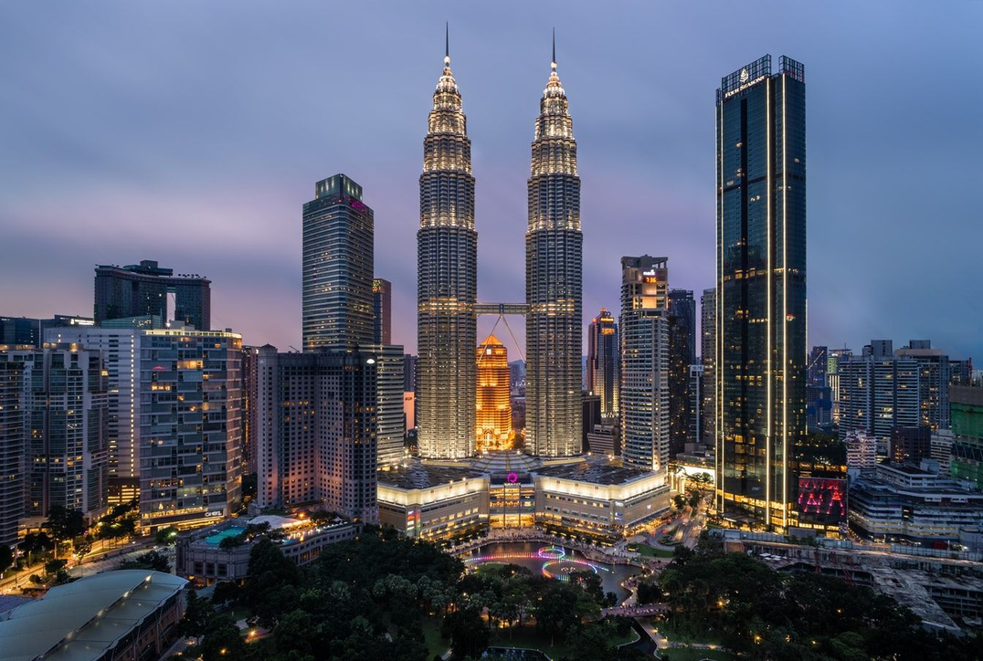
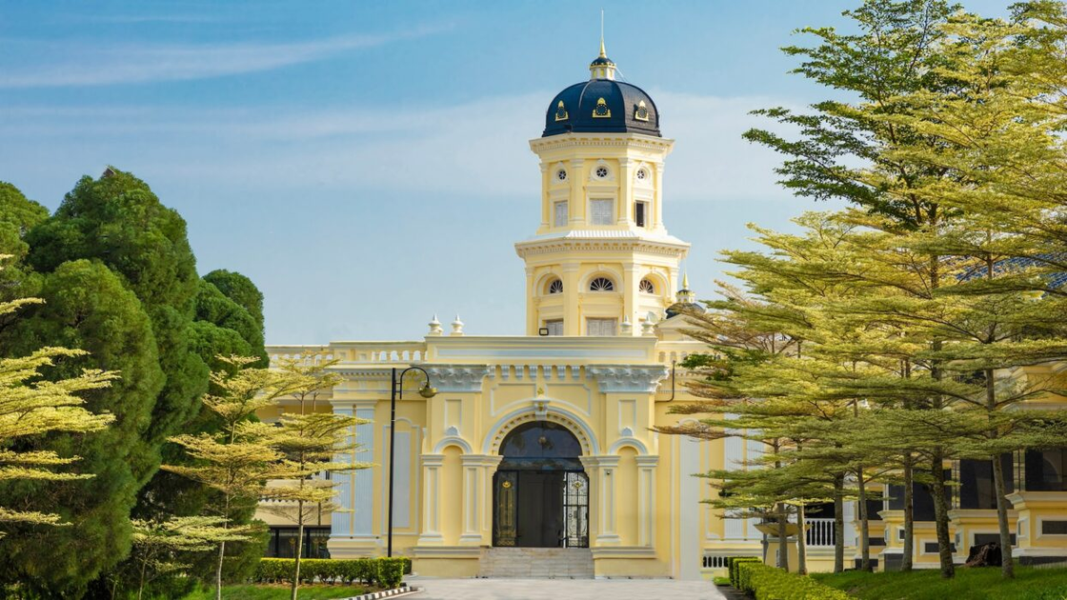
Sales by Store Location
Kuala Lumpur had the highest sales with RM 3,150, followed closely by Johor Bahru with RM 2,997.50. Malacca (RM 2,382.50) and Penang (RM 2,050) had lower sales but still show room for growth. Stronger marketing in these two cities could help increase sales.
Learn More

Slide 8
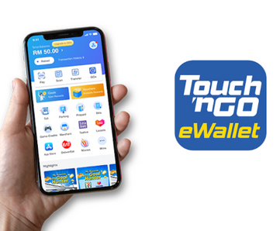
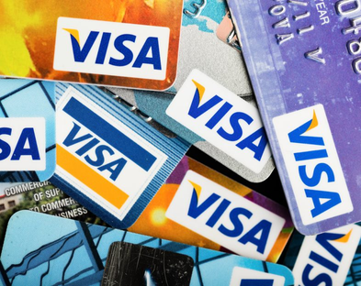
Payment Method Distribution
Most customers preferred digital payments such as e-wallets and cards instead of cash. This matches Malaysia’s move toward a digital economy. To support this, the store can offer e-wallet rewards, discounts for cashless payments, and faster digital checkouts.

Slide 9
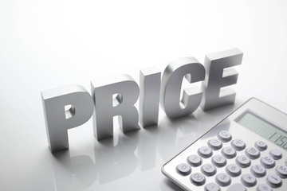

Lower-priced products sold in larger numbers, while higher-priced products sold in smaller numbers. This means customers are sensitive to price, but premium items are still attractive to shoppers who are willing to spend more.
01
02
Price vs. Quantity
03

Slide 10
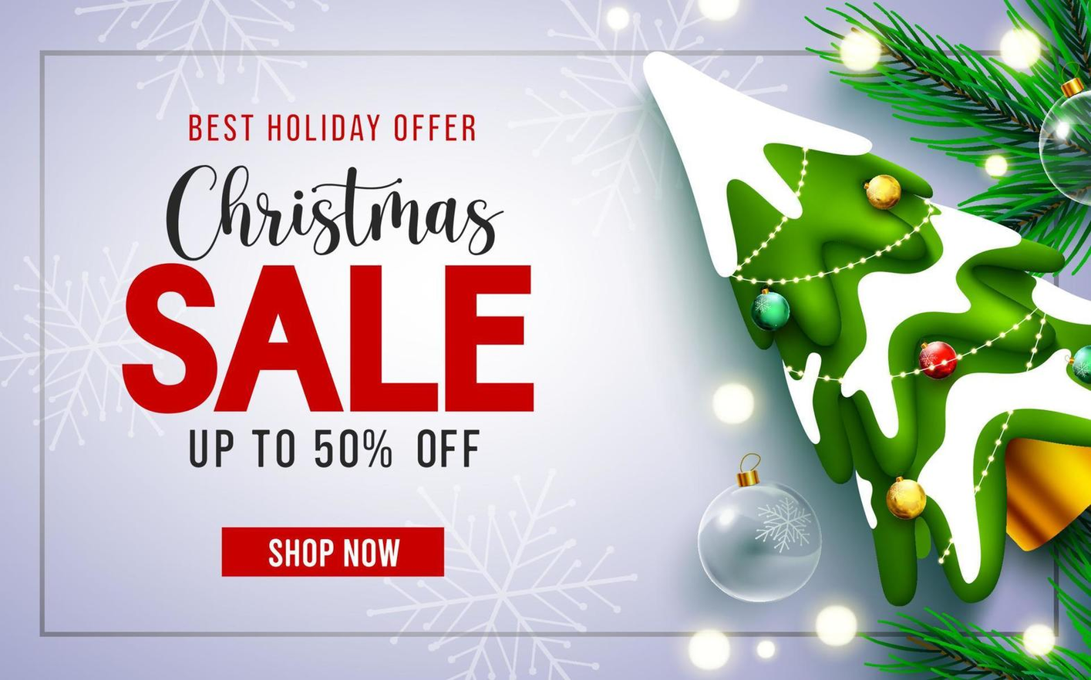
The store should stock more fast-selling items like beverages, personal care, and snacks. It should increase marketing in Penang and Malacca to grow sales. Promotions should be held during festive periods to make the most of higher demand. The store should also encourage digital payments with rewards and discounts. Finally, it should offer both affordable FMCG products and a few premium items to serve all customer groups.
Key Recommendations

Slide 11
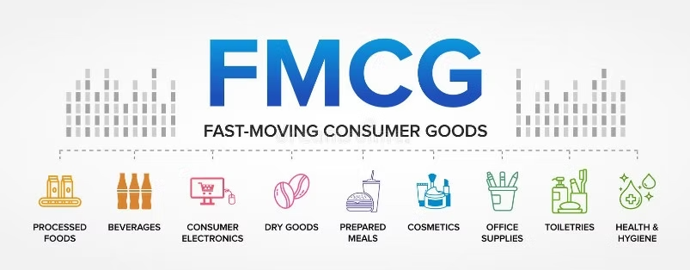
Conclusion
01
The store is strong in the FMCG market, especially in beverages and personal care. Kuala Lumpur and Johor Bahru lead in sales, while Penang and Malacca are growth opportunities. By improving regional marketing, running festive promotions, and upgrading digital payments, the store can attract more customers and increase profits.
02
03

Slide 12
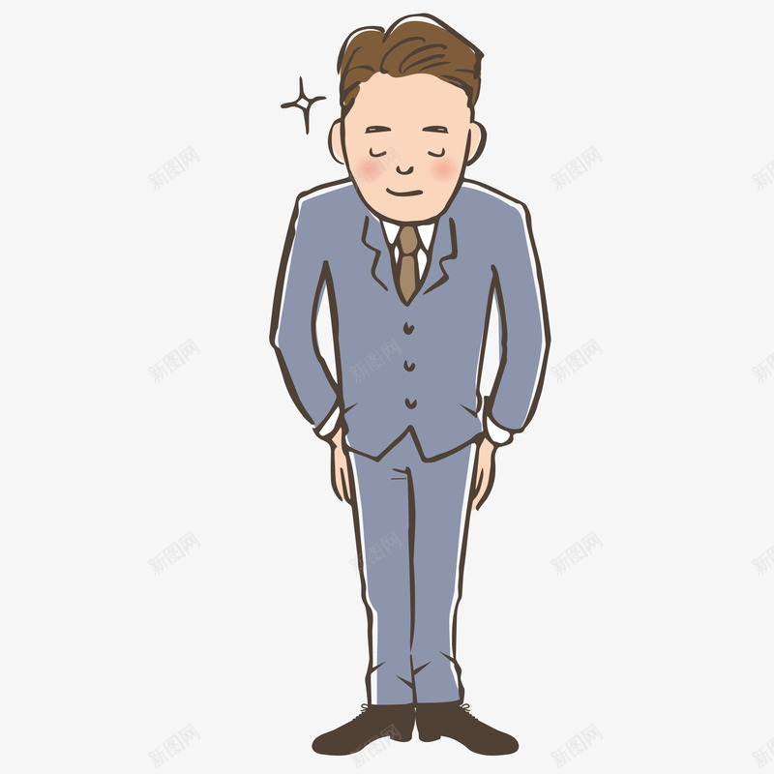
Thank You
FOR YOUR ATTENTION

